Slide 1
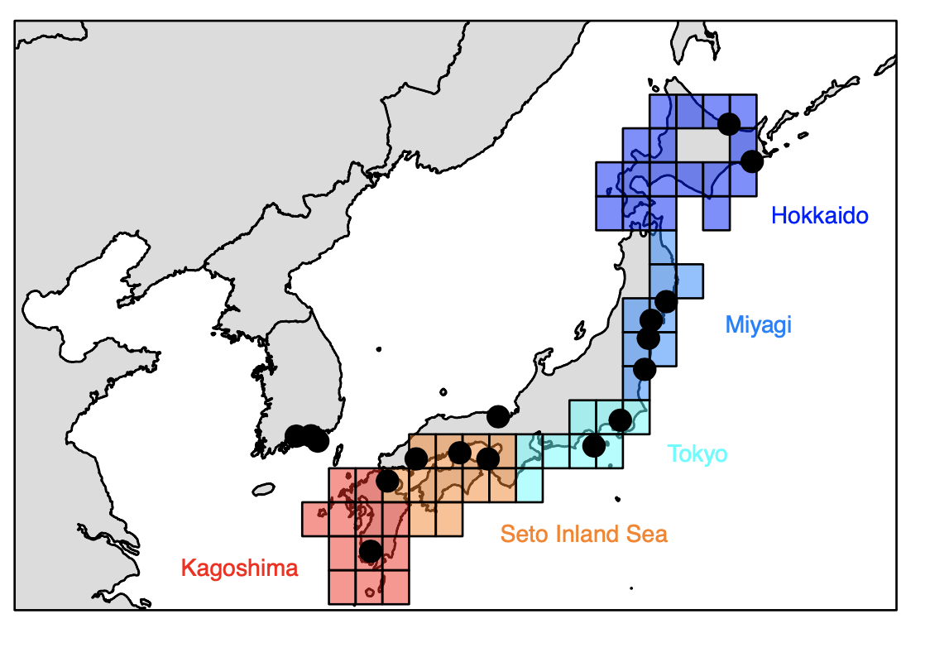
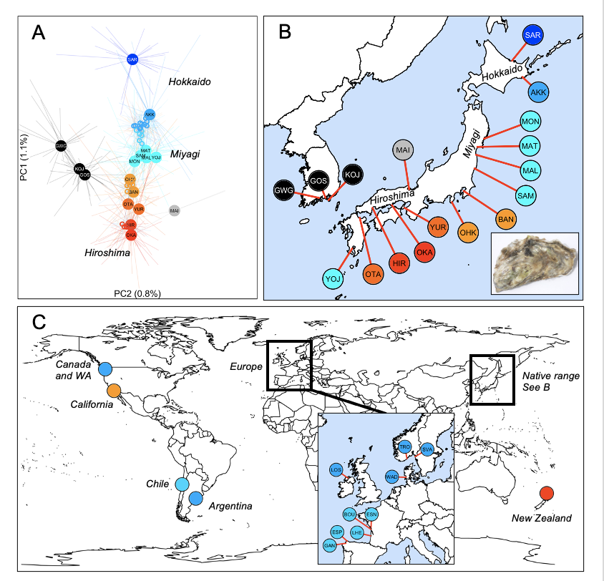
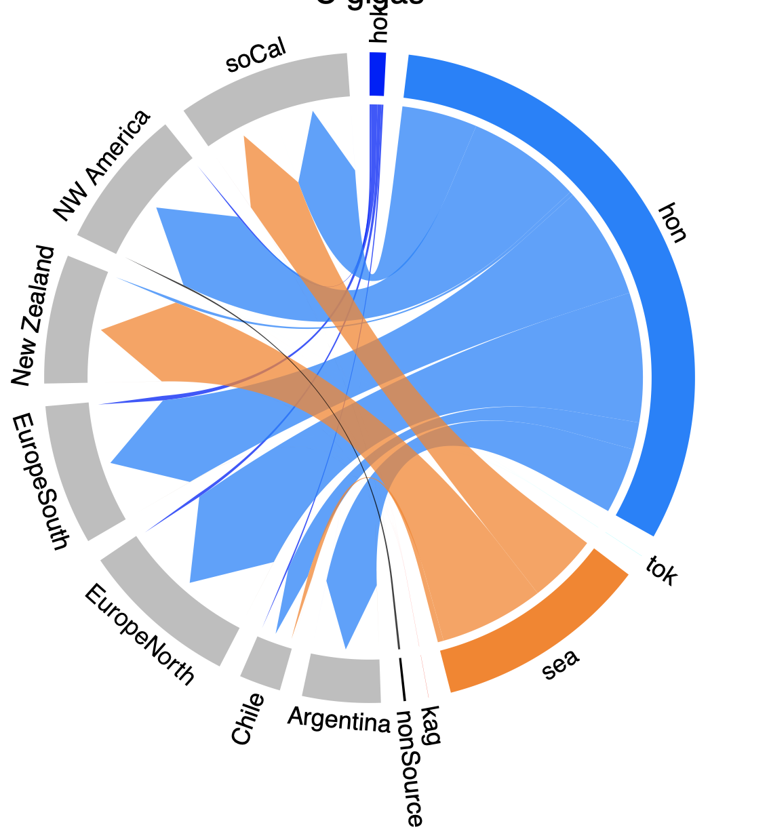
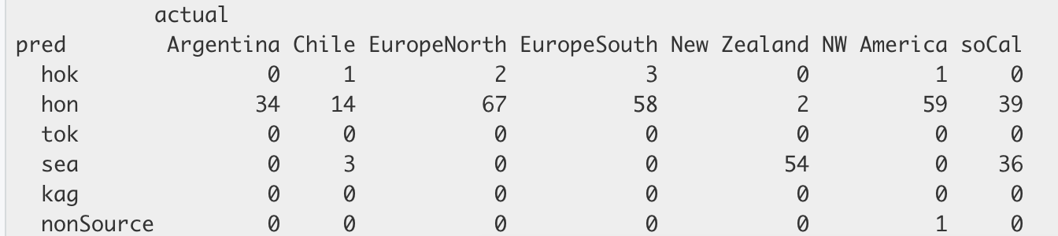
Crassostrea gigas
SNP data
Original data
ML output = cross validation accuracy 69.9%

Slide 2
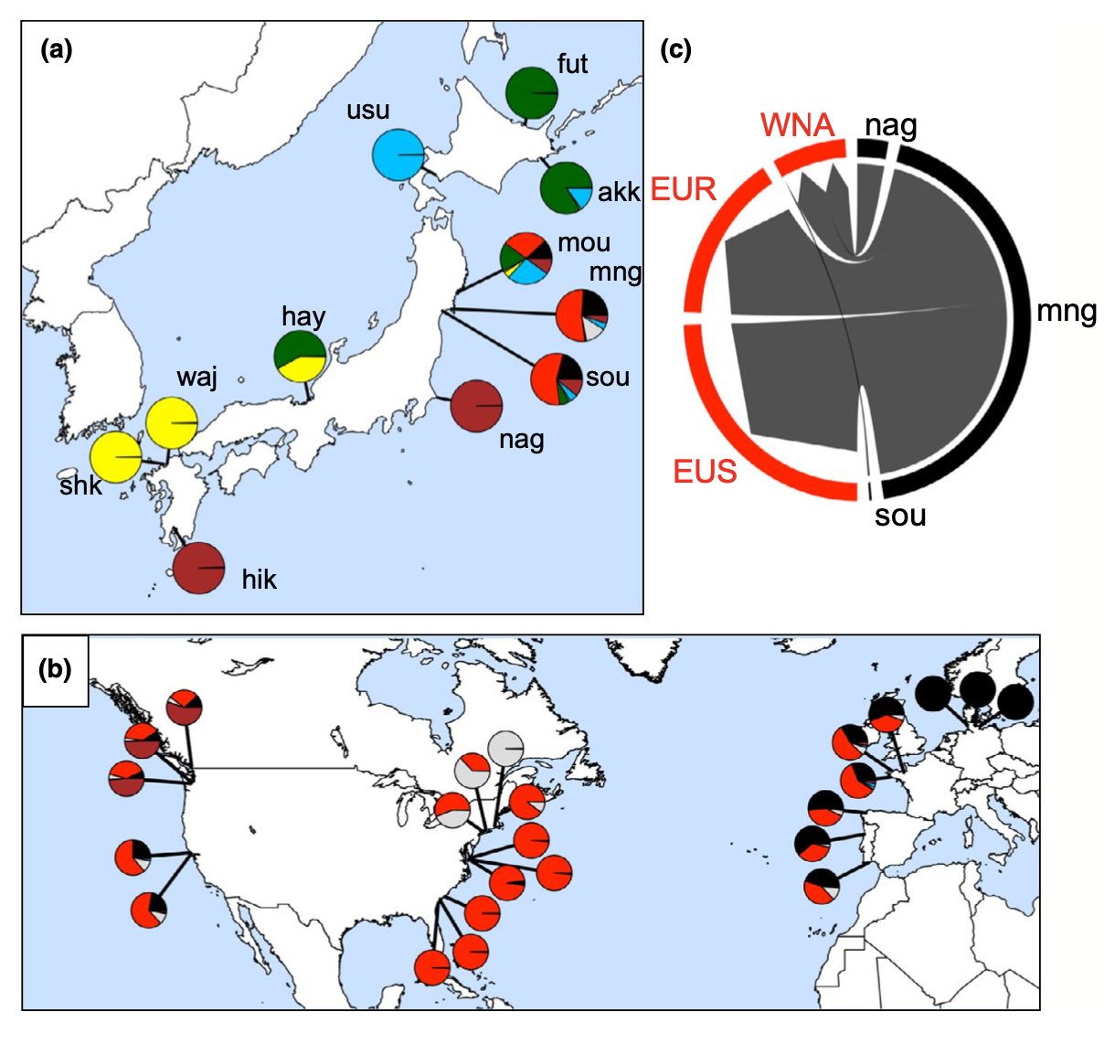
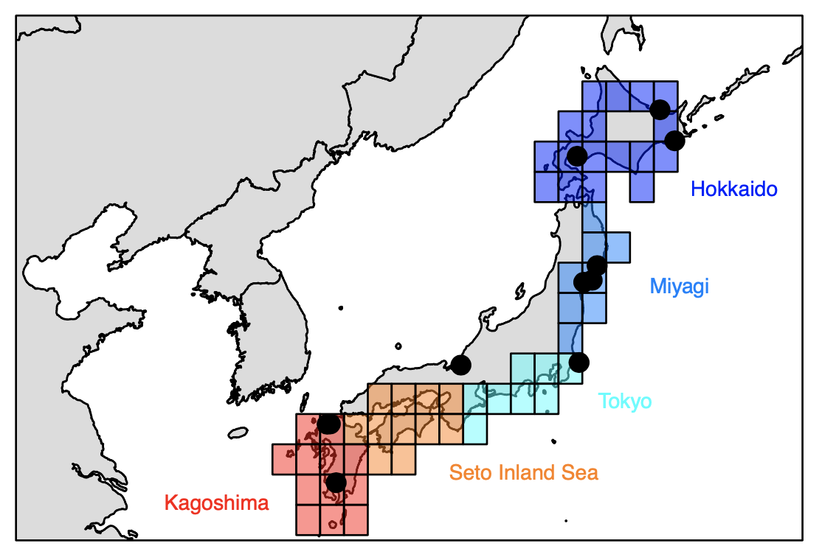
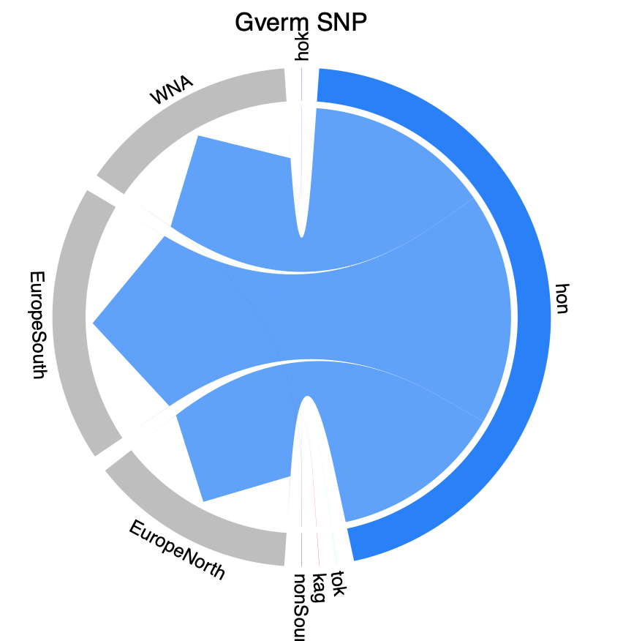
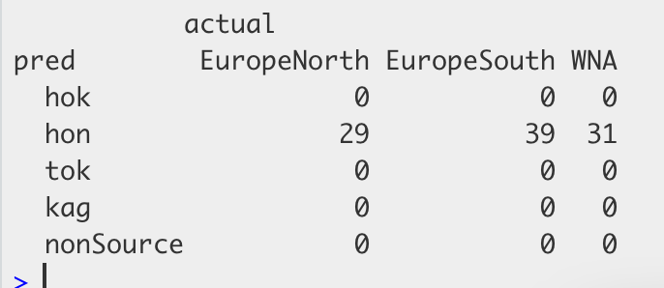
Gracilaria vermiculophylla
Alga
SNP data
Original data – Flanagan et al 2021
ML output = cross validation accuracy 100.0%

Slide 3
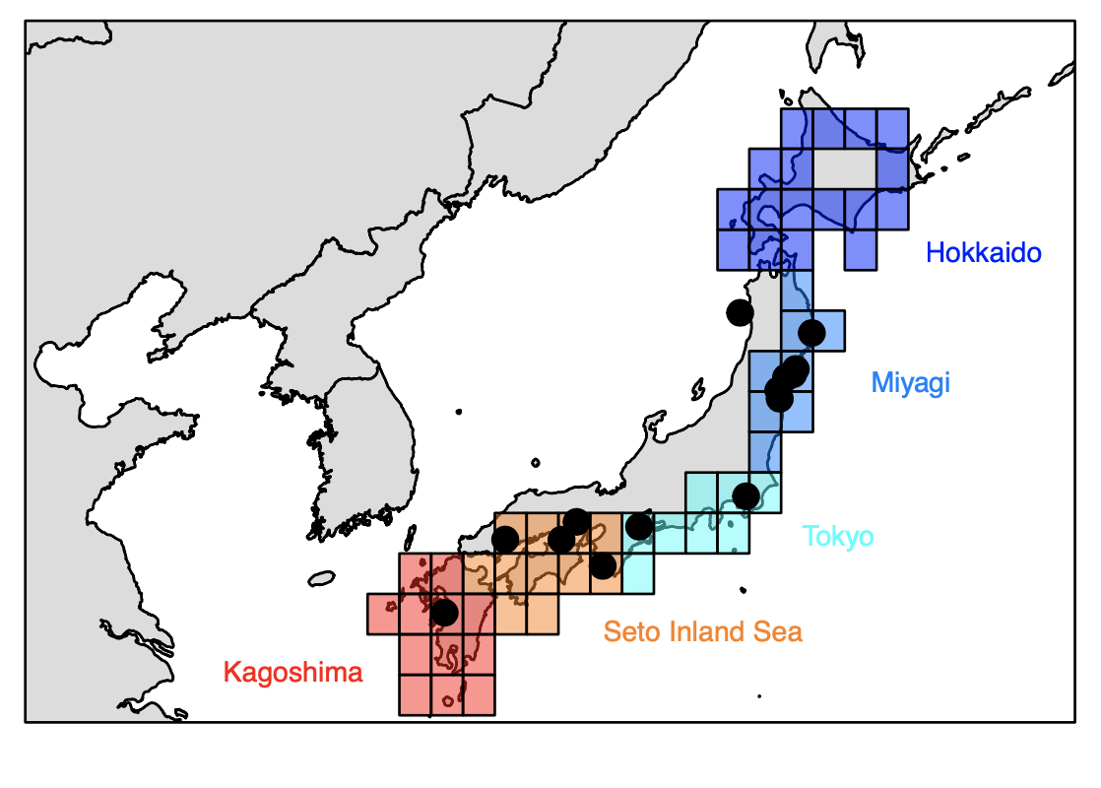
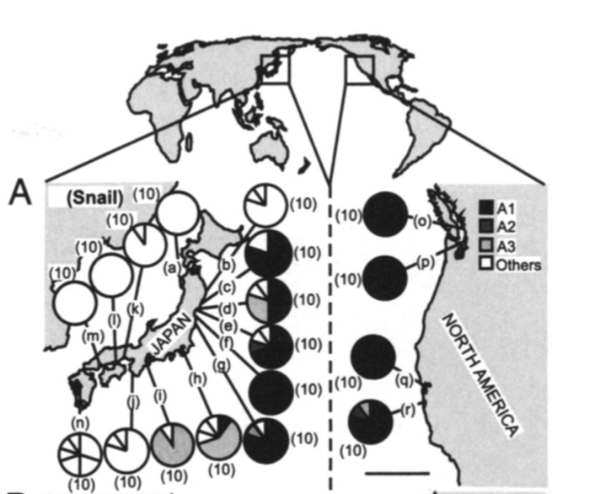
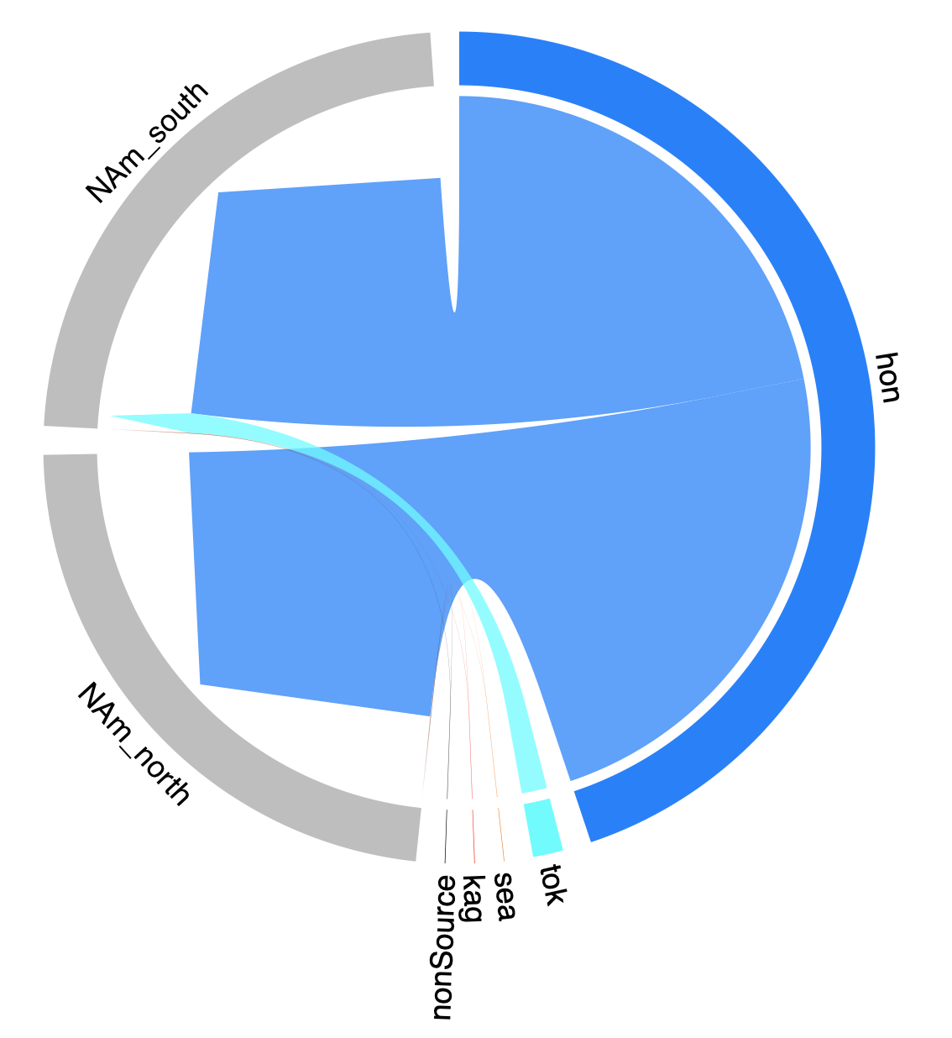
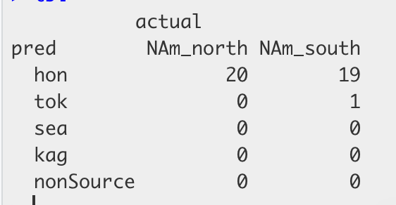
Batillaria attramentaria
Japanese False Cerith - mollusc
mtDNA data
Original data – Miura et al 2006 PNAS
ML output = cross validation accuracy 85.3%

Slide 4
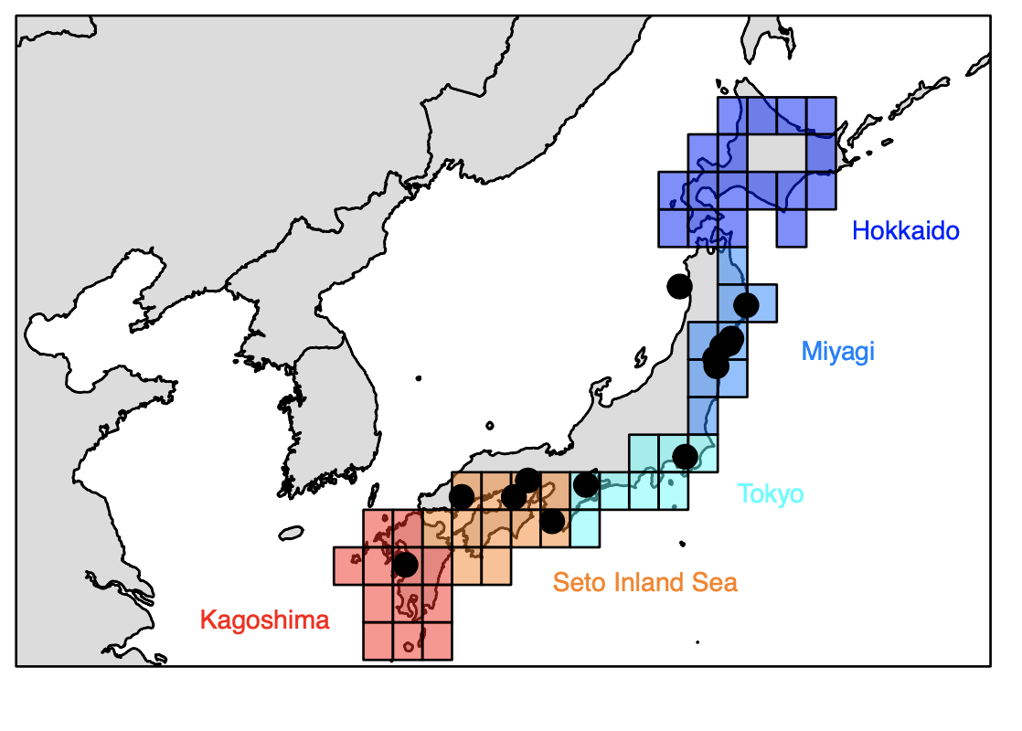
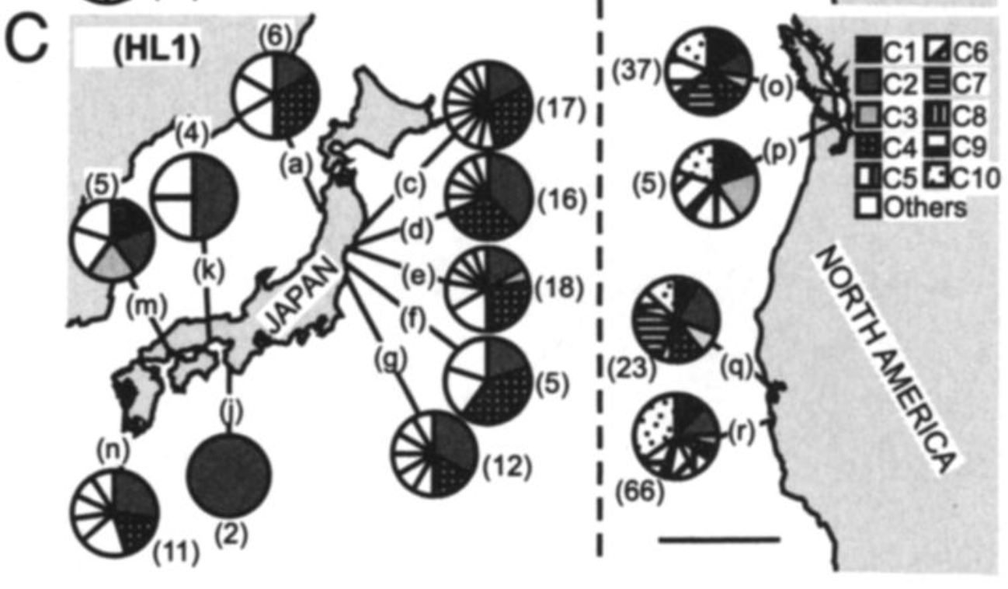
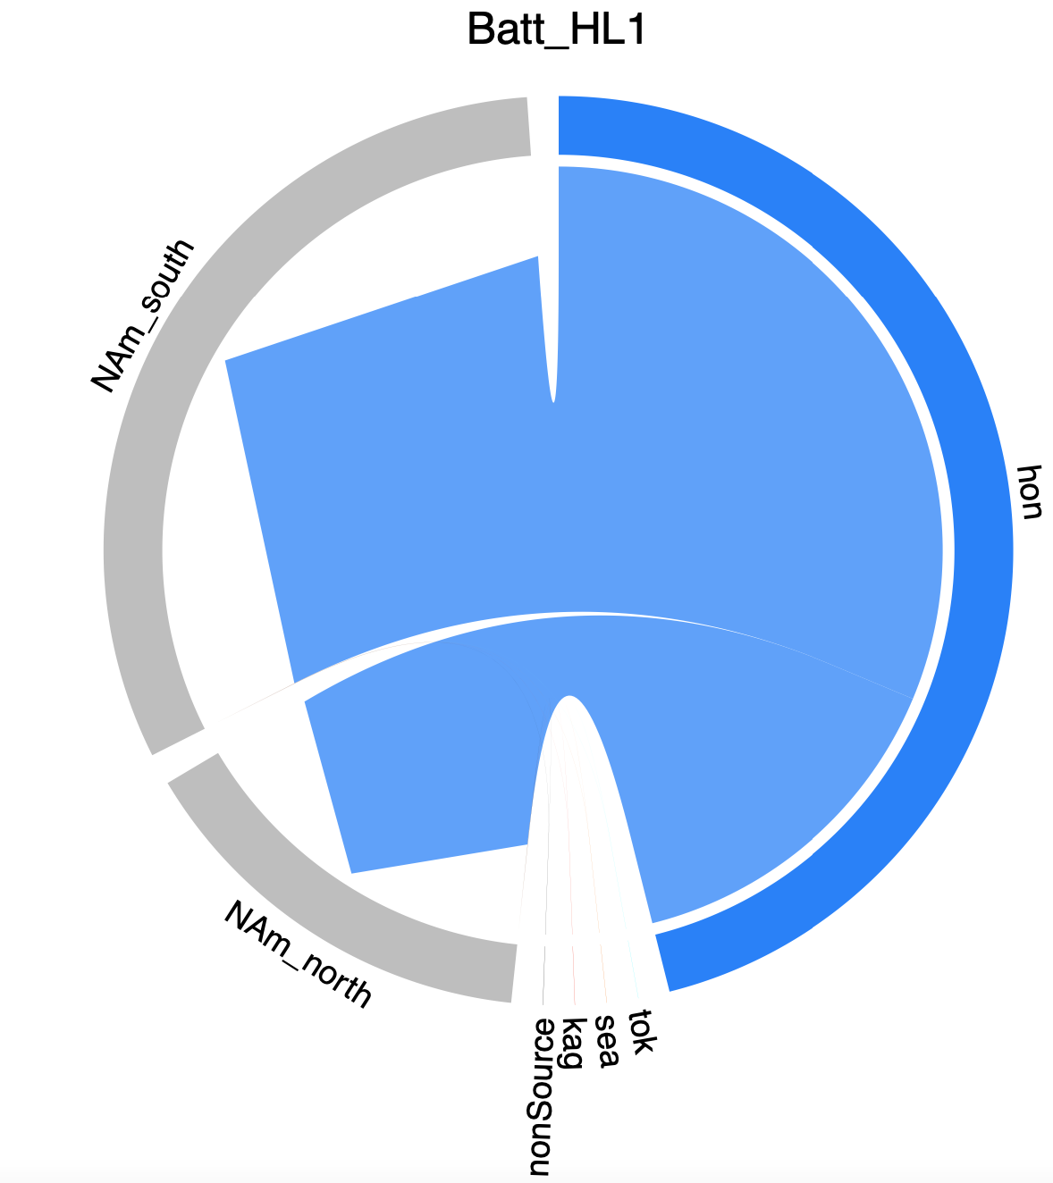
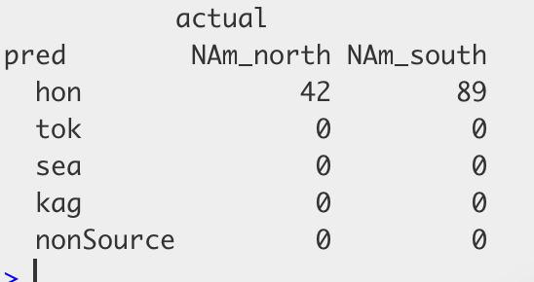
Cercaria batillaria HL1
Trematode
mtDNA data
Original data – Miura et al 2006 PNAS
ML output = cross validation accuracy 68.0%

Slide 5
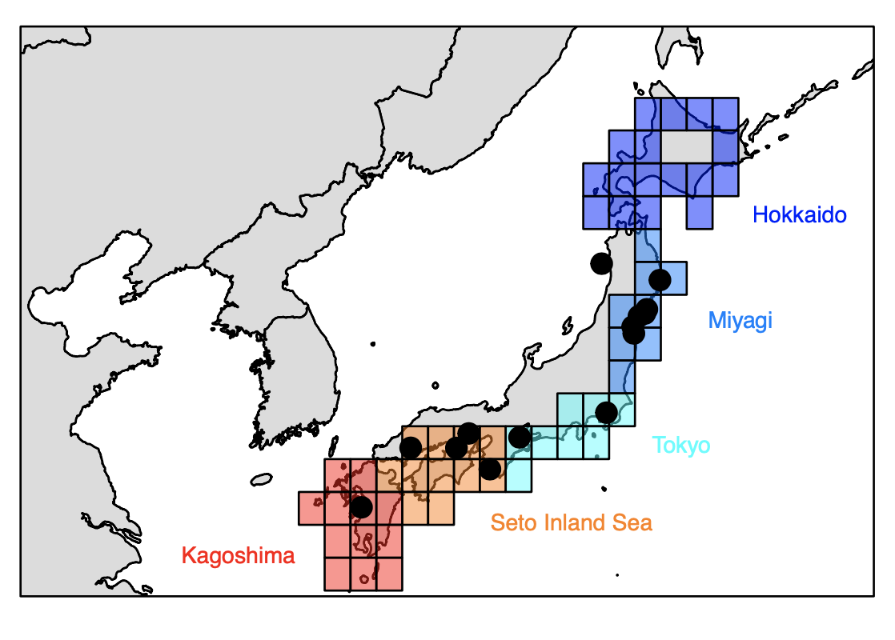
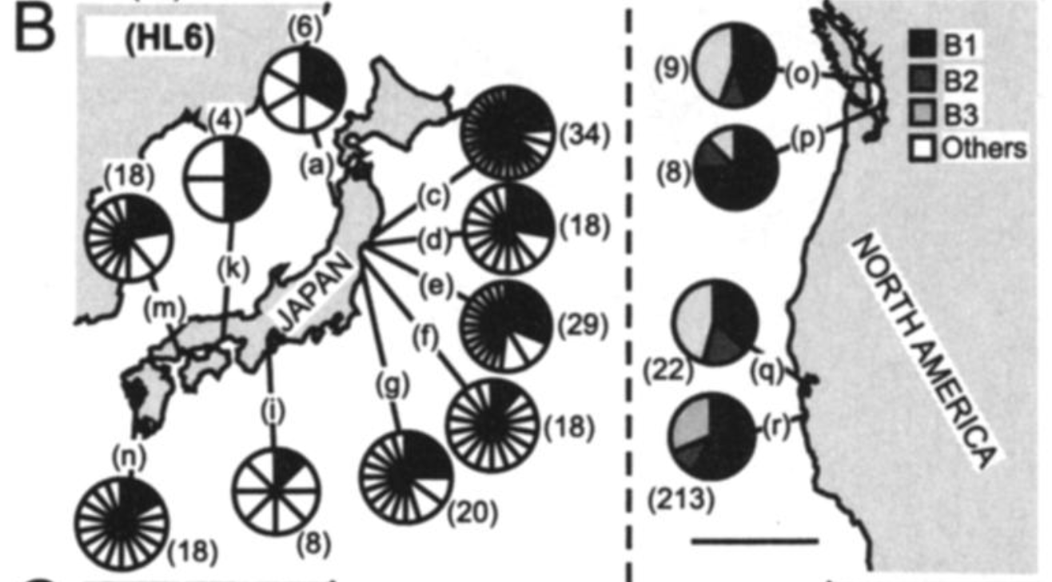
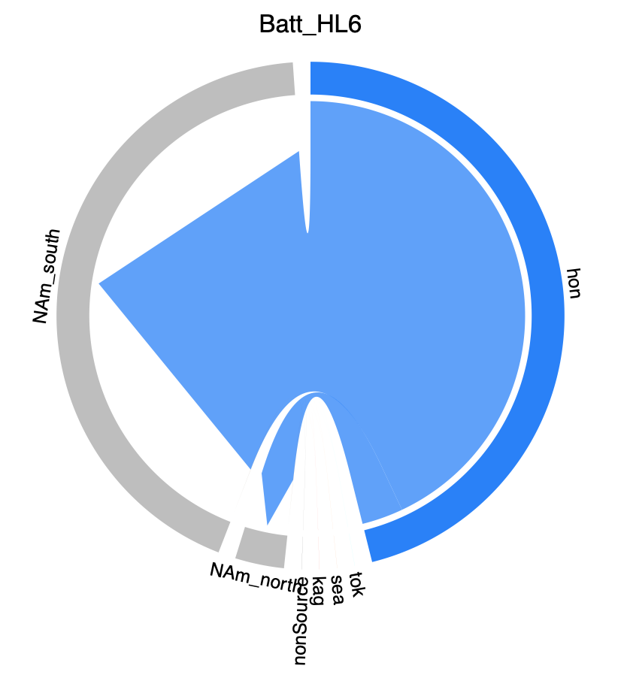
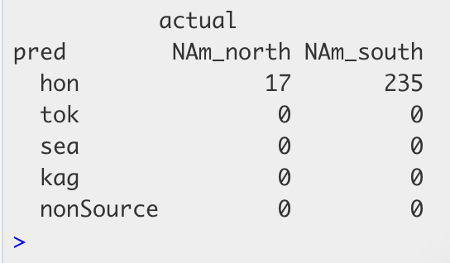
Cercaria batillaria HL6
Trematode
mtDNA data
Original data – Miura et al 2006 PNAS
ML output = cross validation accuracy 67.5%

Slide 6
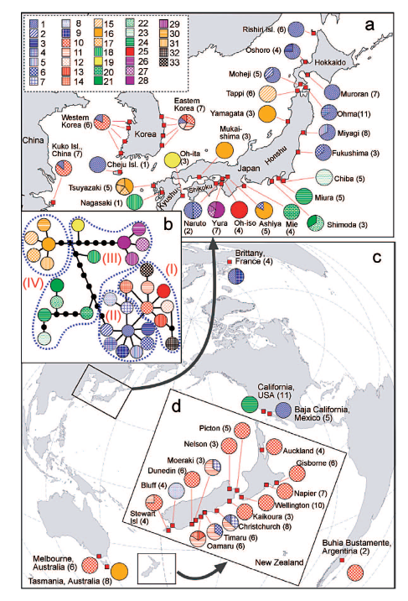
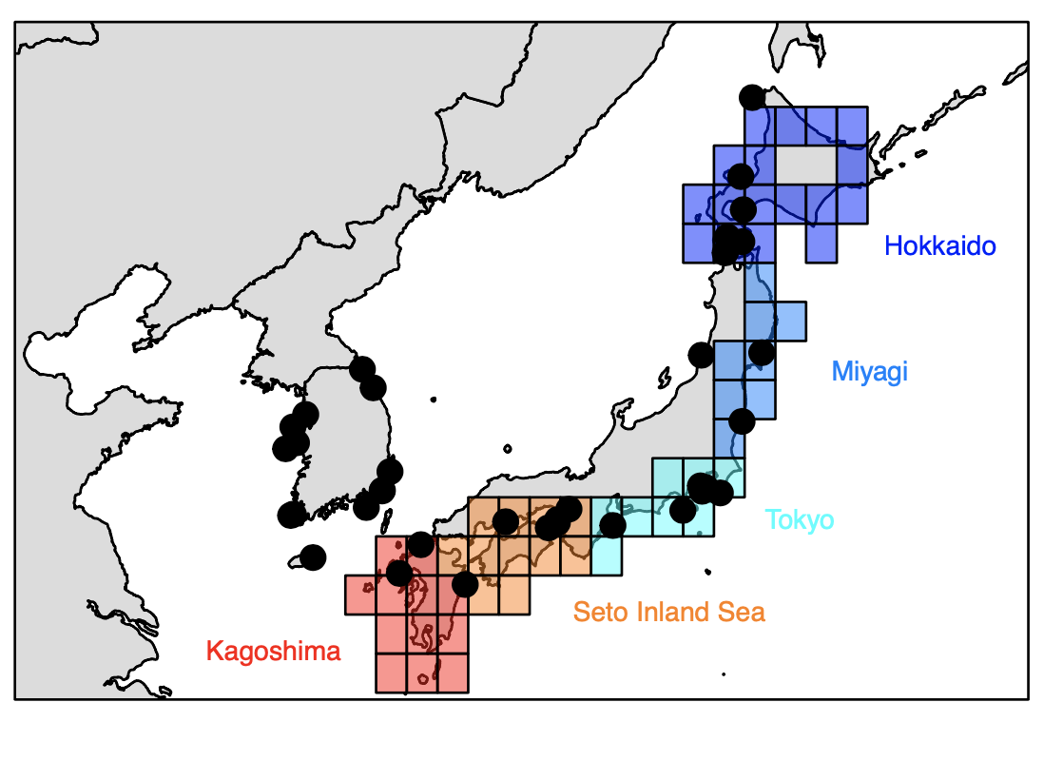
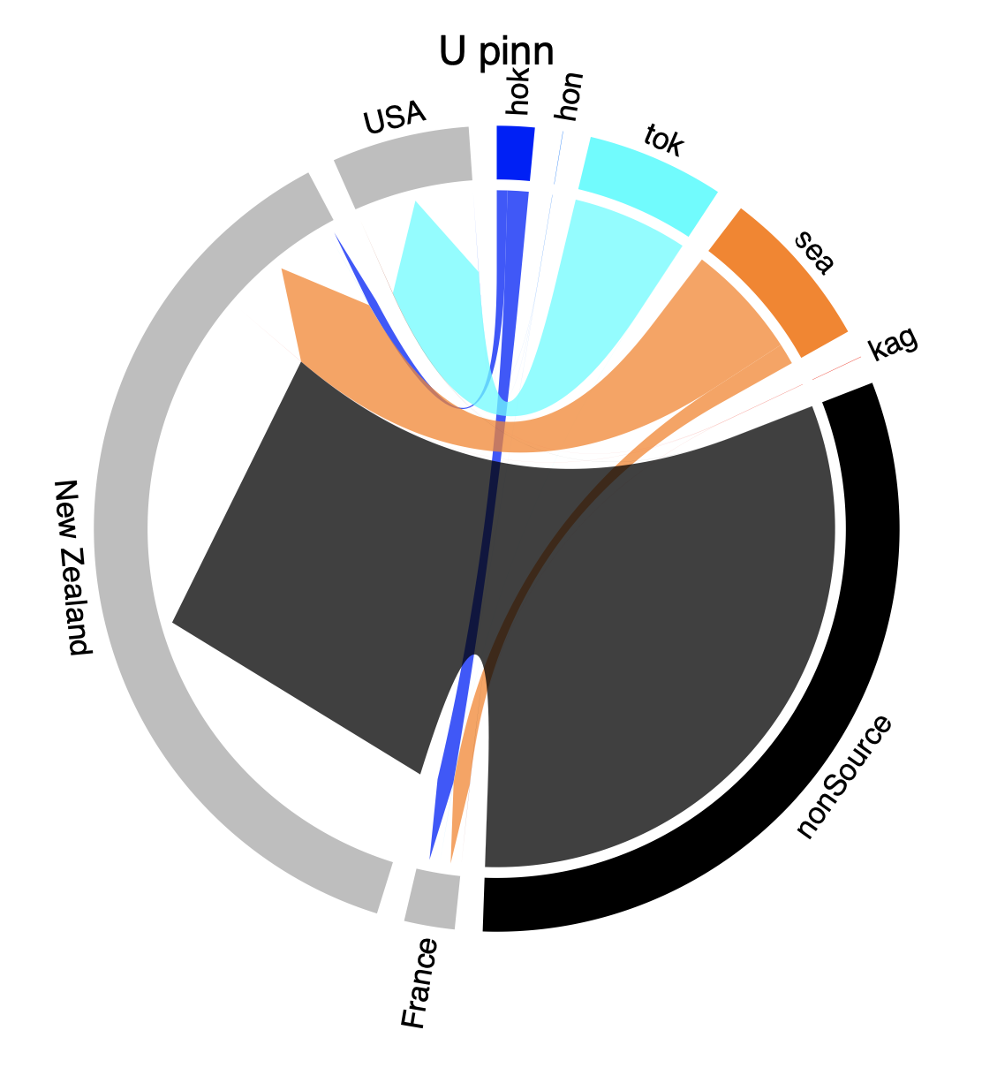
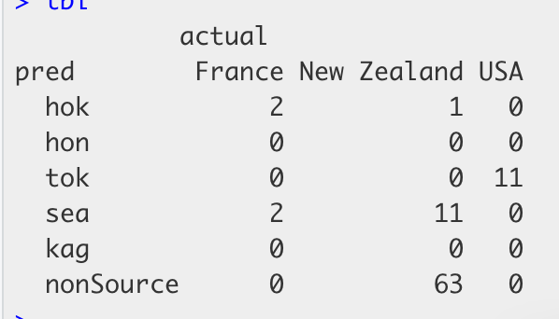
Undaria pinnitifida
Wakame - Alga
mtDNA data
Original data – Uwai et al 2006
ML output = cross validation accuracy 76.4%

Slide 7
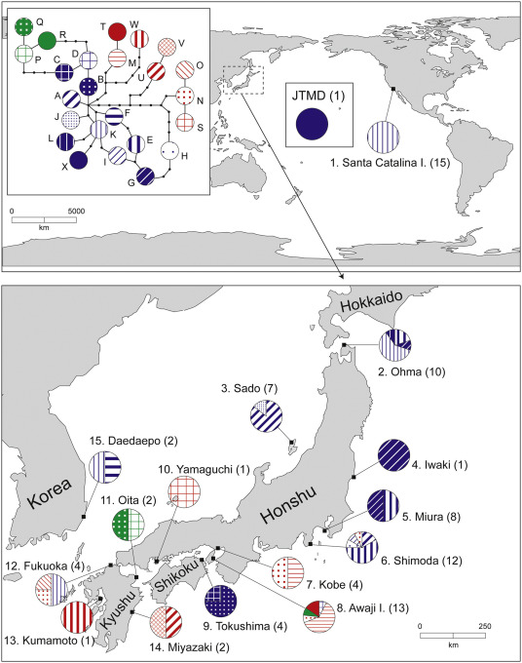
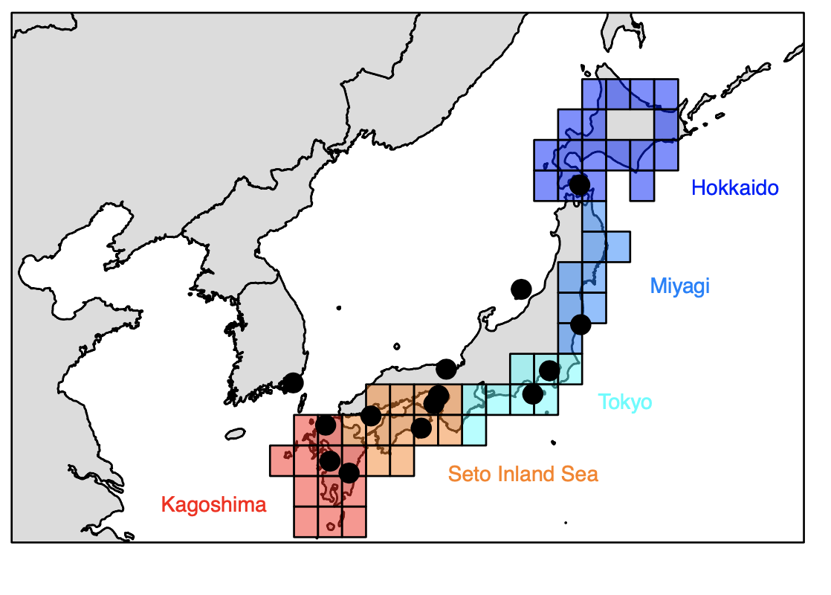
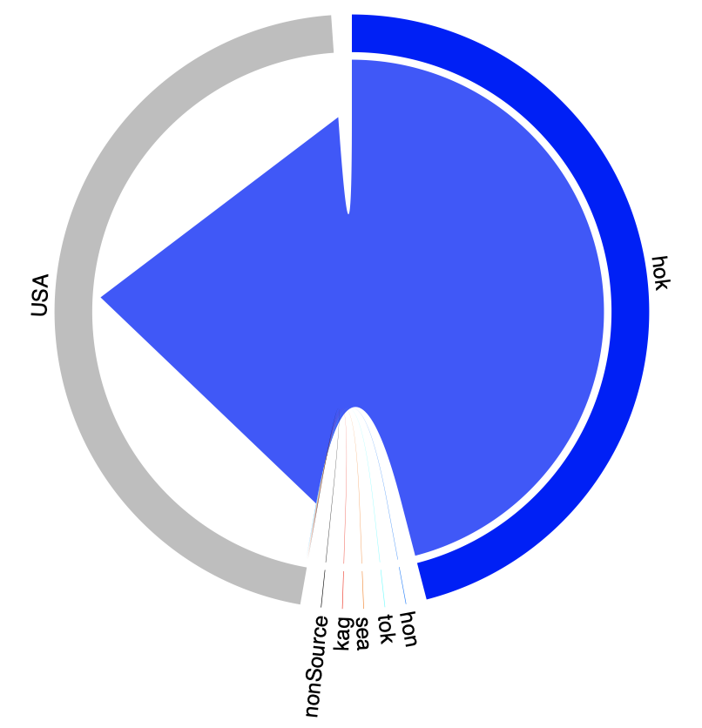
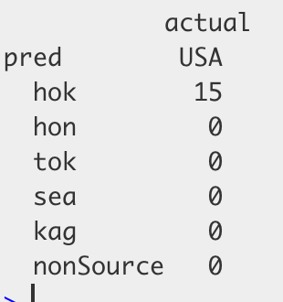
Mutimo cylindricus
Alga
mtDNA data
Original data – Hanyuda et al. 2018
ML output = cross validation accuracy 72.7%

Slide 8
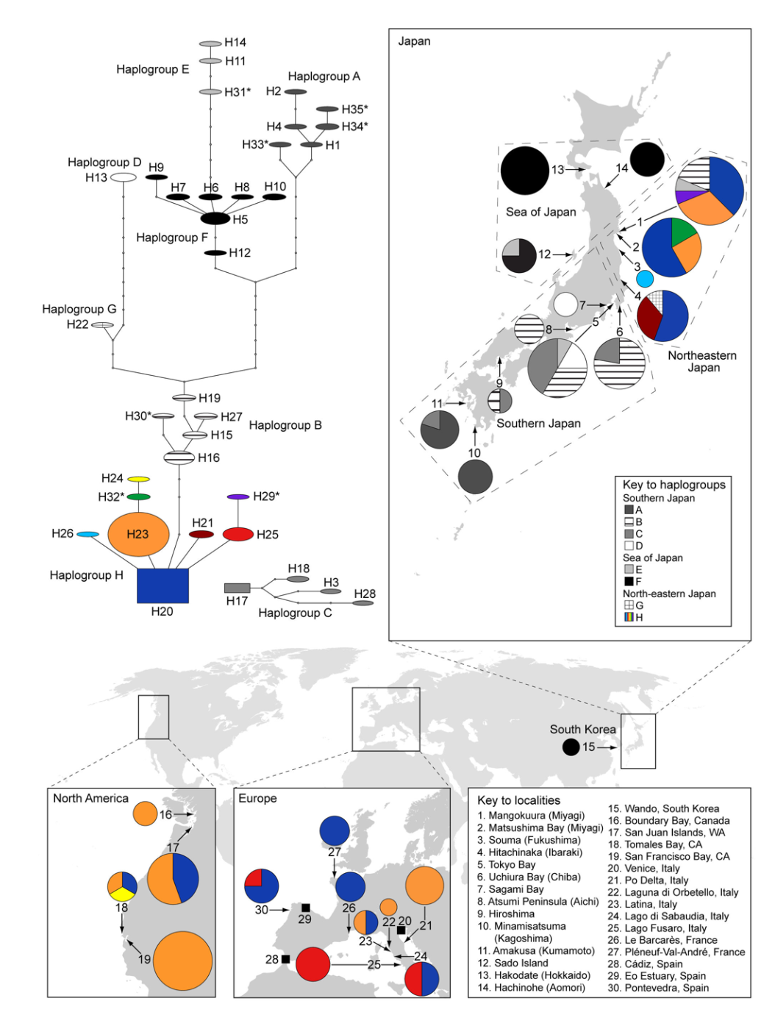
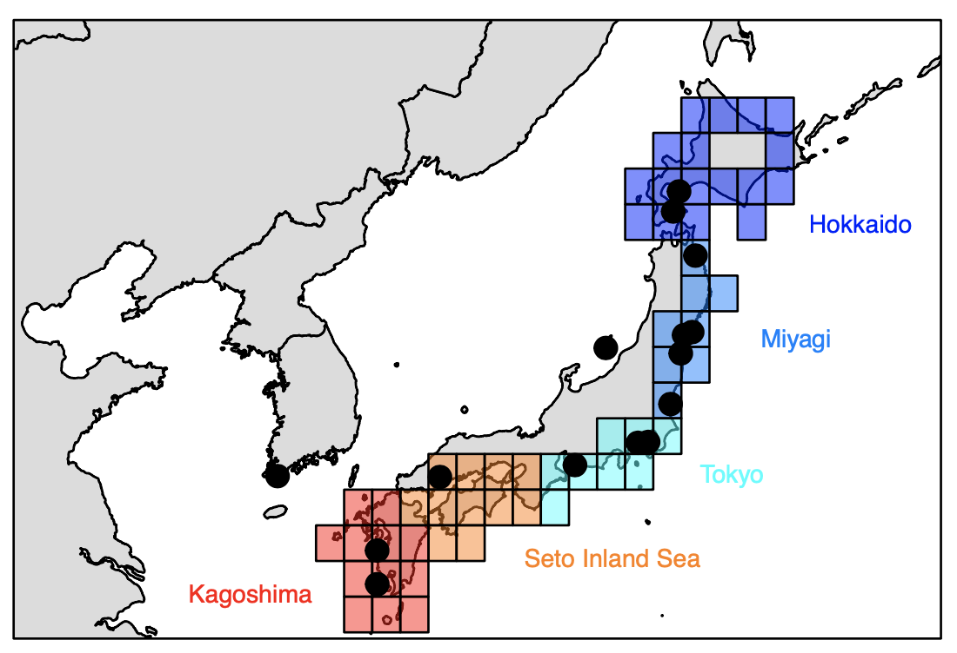
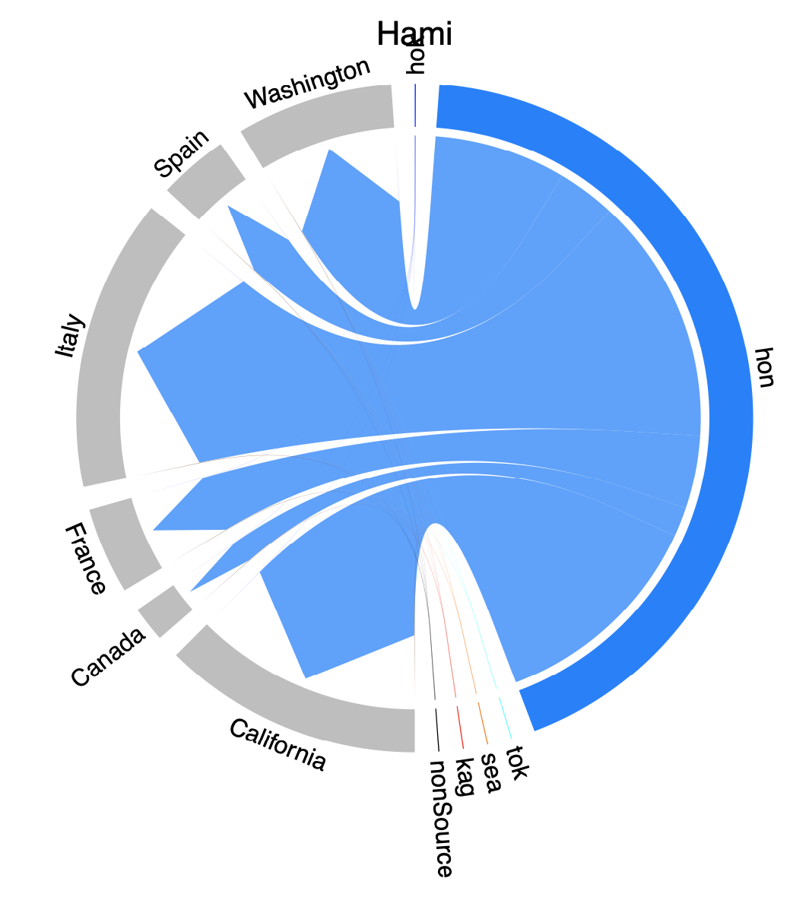
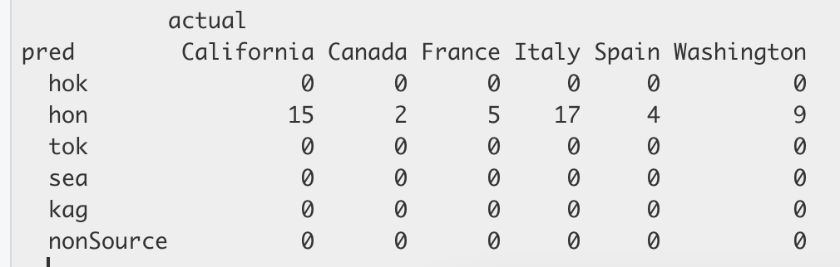
Haminoea japonica
Japanese bubble snail - Mollusc
mtDNA data
Original data – Hansen et al. 2013 PLOSONE
ML output = cross validation accuracy 65%

Slide 9
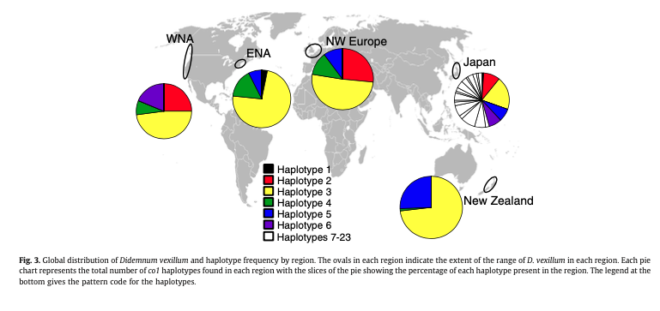
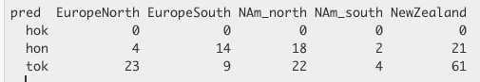
Original data – Stefanik et al 2012 JEMBE
Didemnum vexillum
Ascidian
mtDNA data
ML output = cross validation accuracy 88.9%

Slide 10
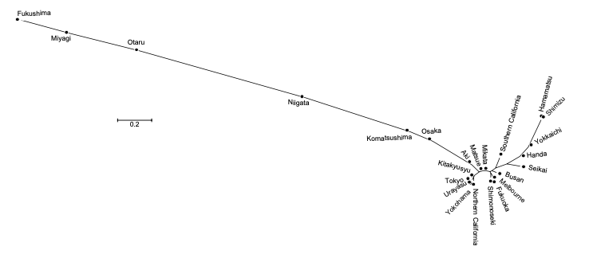
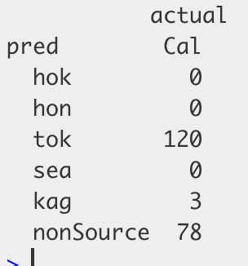
Original data – Hirase et al 2017
Acanthogobius flavimanus
Yellowfin goby - Chordate
mtDNA data
ML output = cross validation accuracy 56.3%

Slide 11
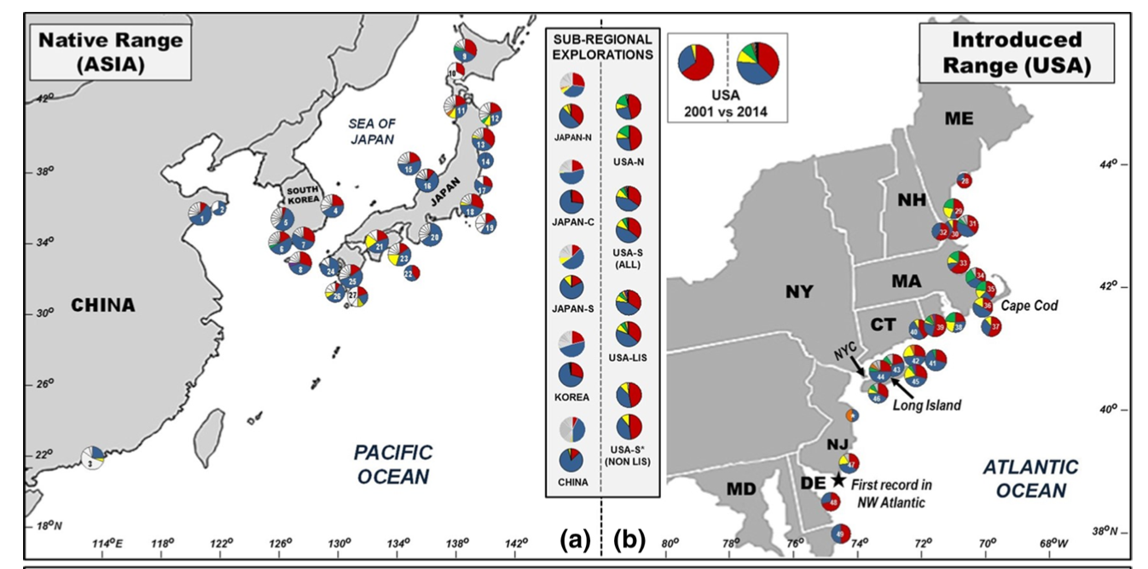
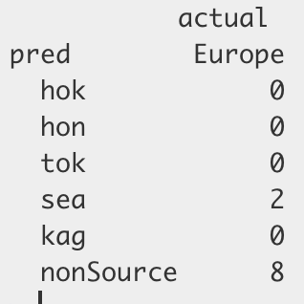
Original data – Blakeslee et al 2017 + GenBank
Hemigrapsus sanguineus
Asian shorecrab
mtDNA data
ML output = cross validation accuracy 49.8%

Slide 12
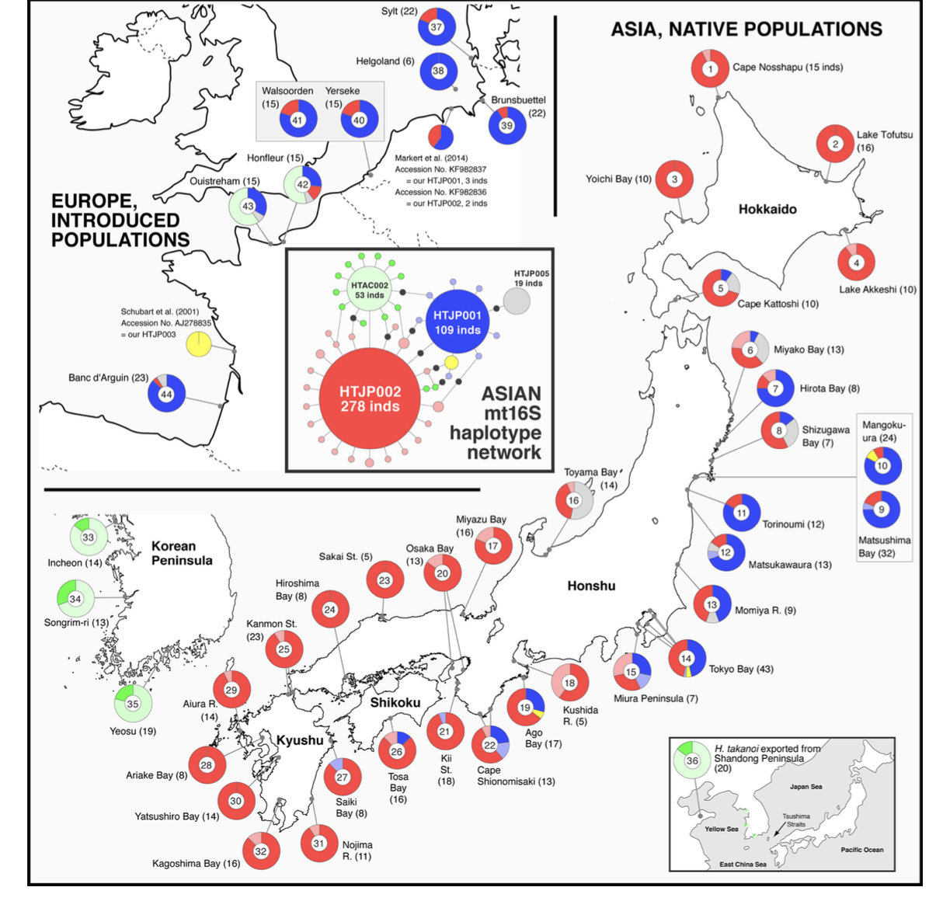
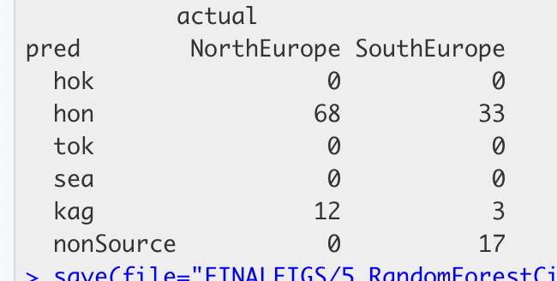
Original data – Mukino et al 2018
Hemigrapsus takanoi
Asian brush-clawed shorecrab
mtDNA data
ML output = cross validation accuracy 46.1%

Slide 13
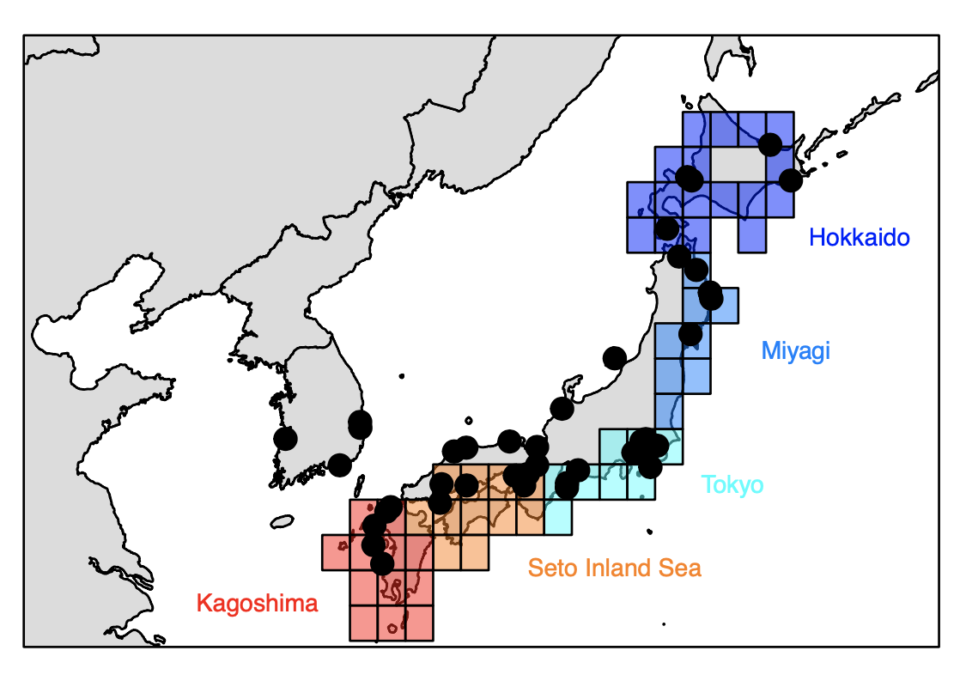
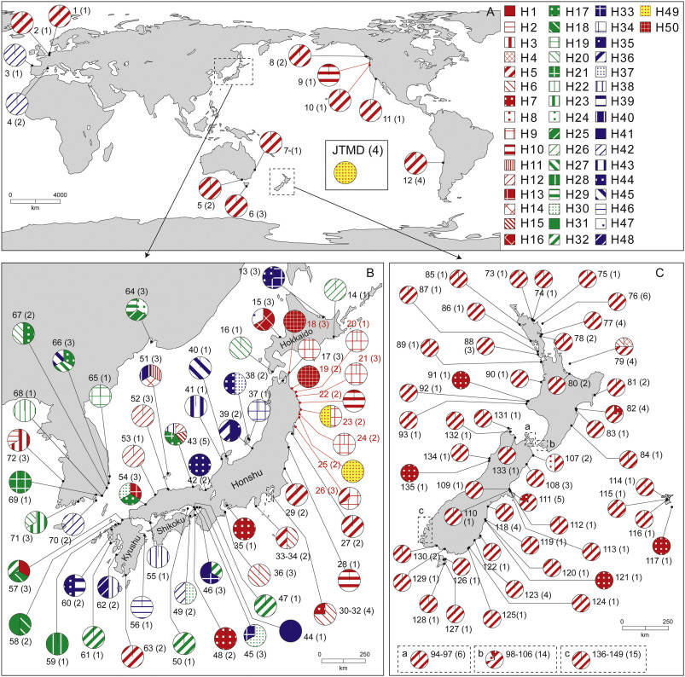
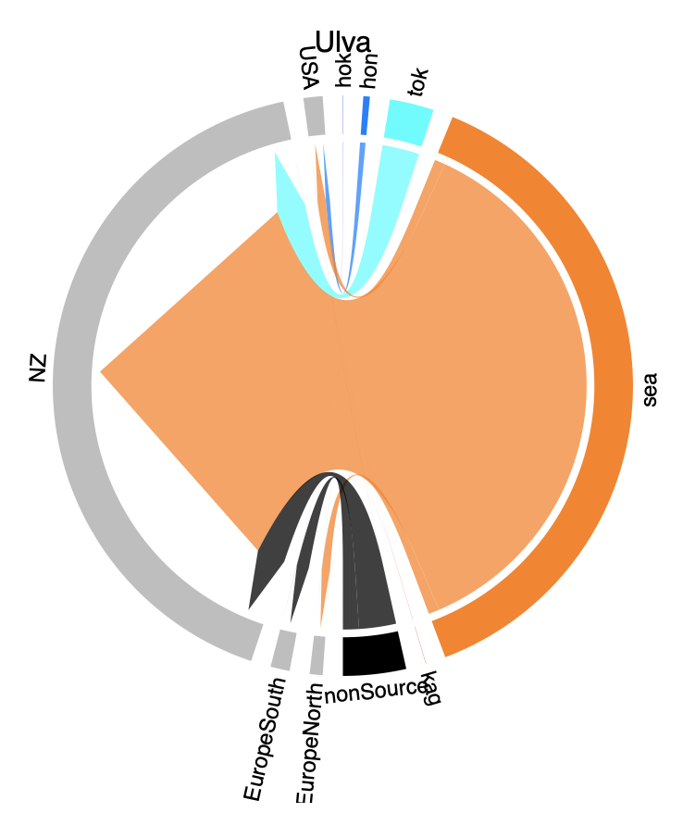
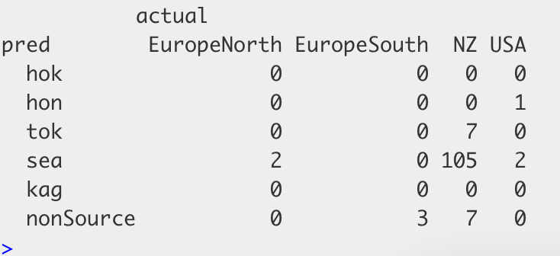
Original data – Hanyuda et al. 2018
Ulva pertusa
Chloroplast and mtDNA data
ML output = cross validation accuracy 48.4%➔ LOW. this may explain why NZ in data and ML differ.

Slide 14
Original data – Uwai et al 2006
Undaria pinnitifida
mtDNA data
ML output = cross validation accuracy 76.4%

Slide 15
OTHER

Slide 16
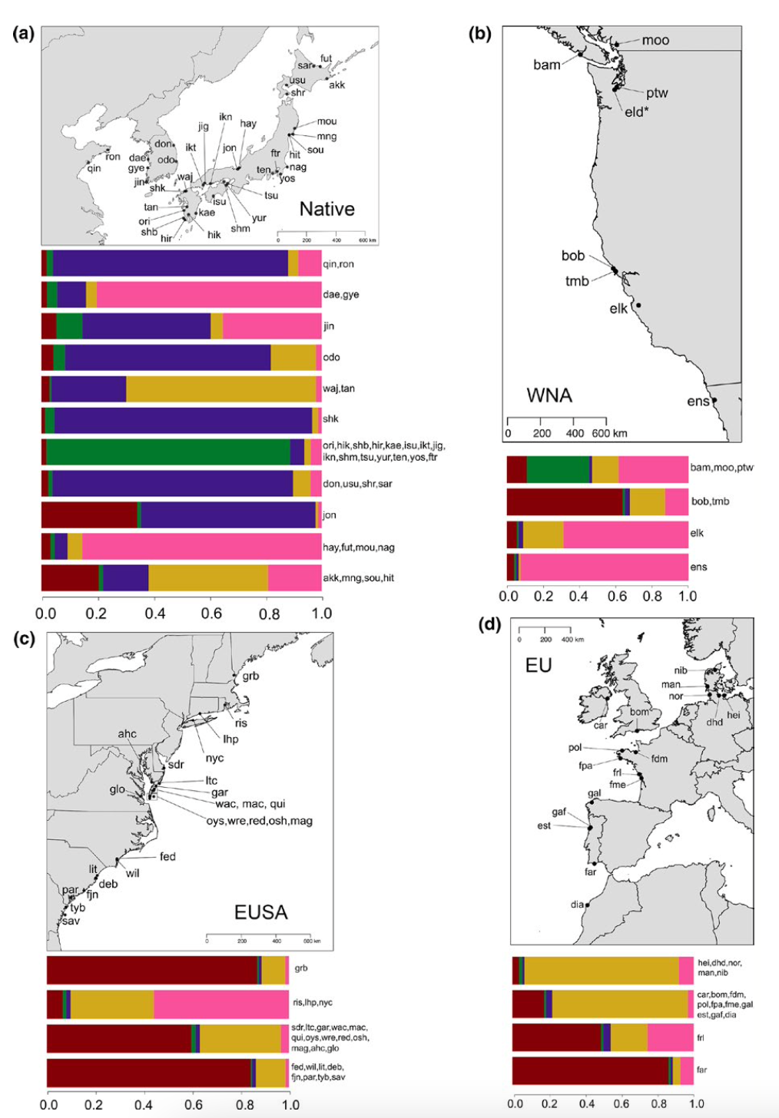
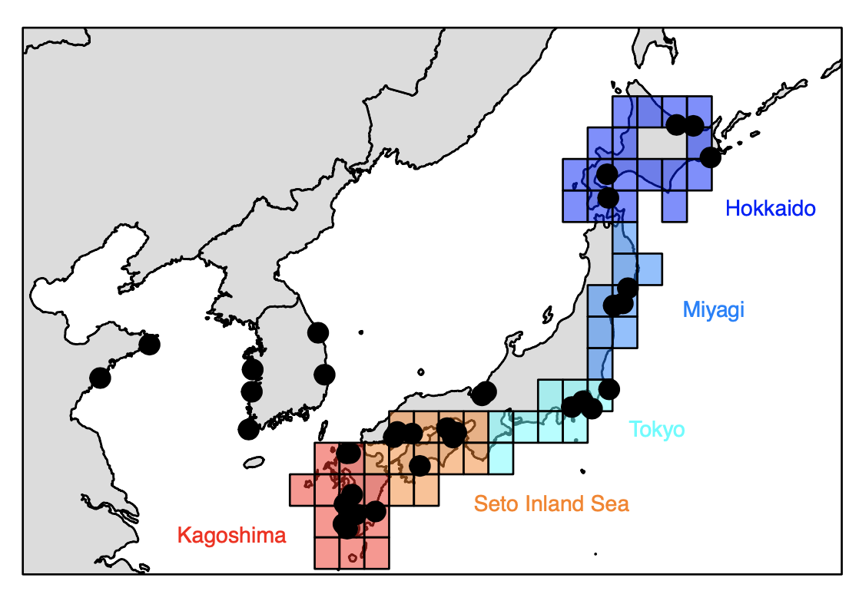
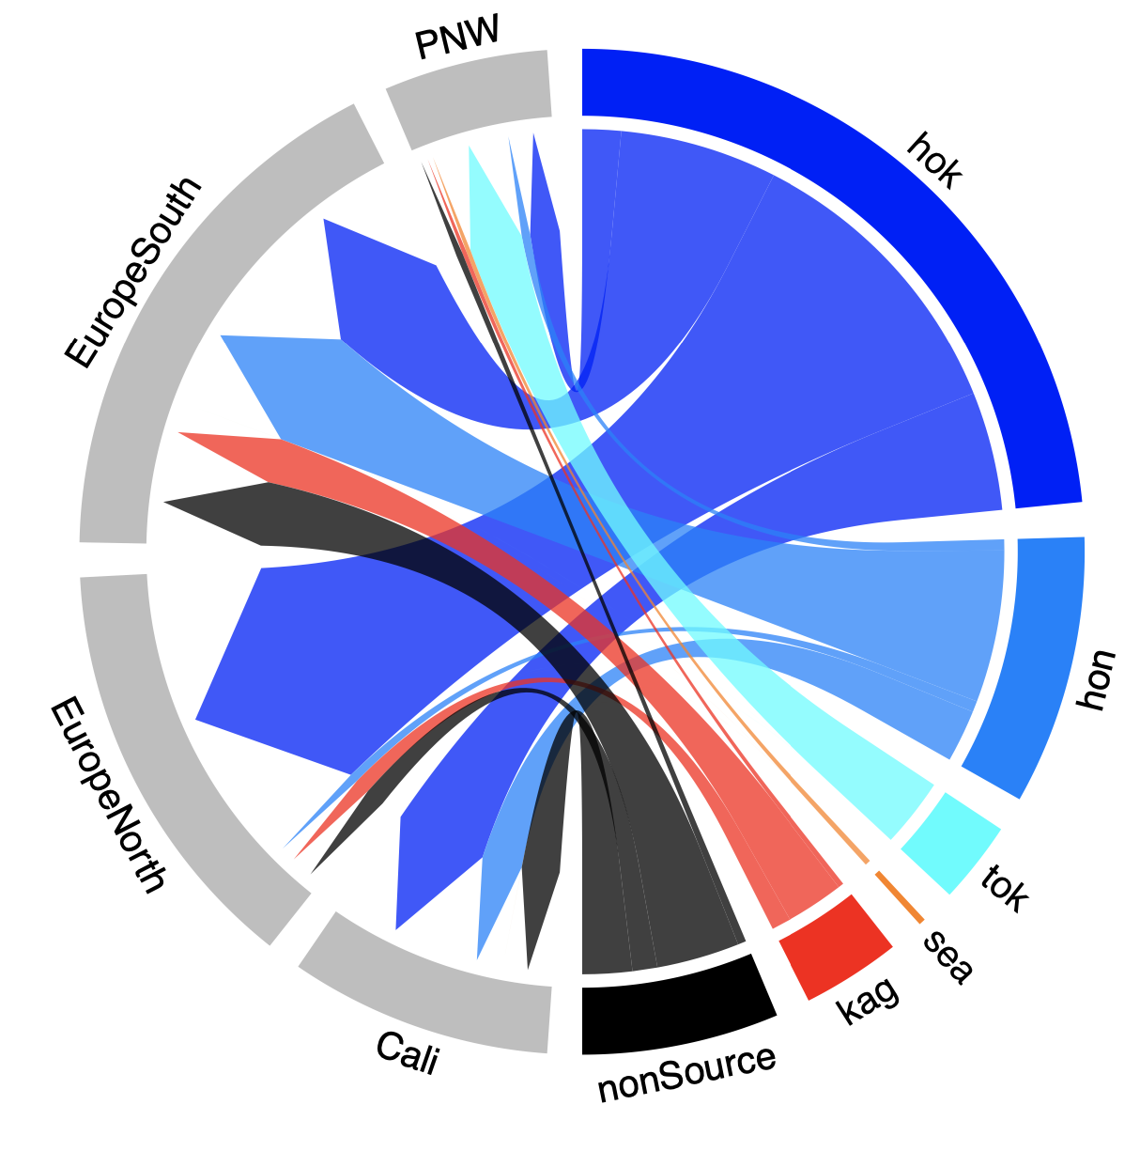
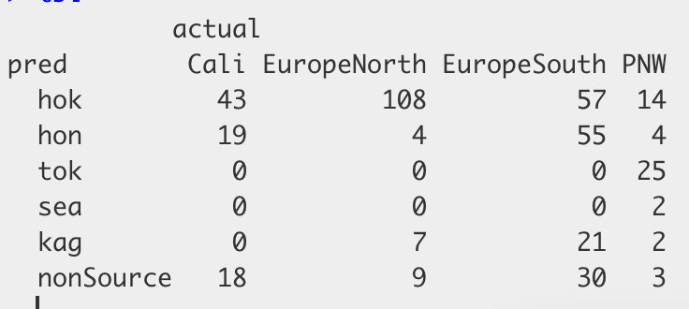
Original data – Krueger-Hadfield et al 2017
Gracilaria vermiculophylla
Usat data
ML output = cross validation accuracy 93.0%

Slide 17
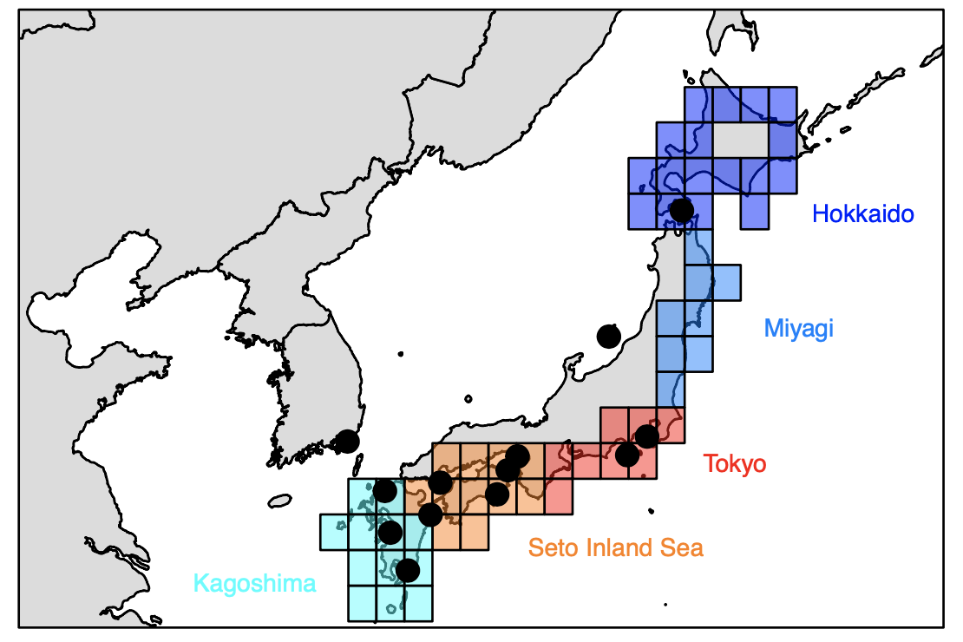
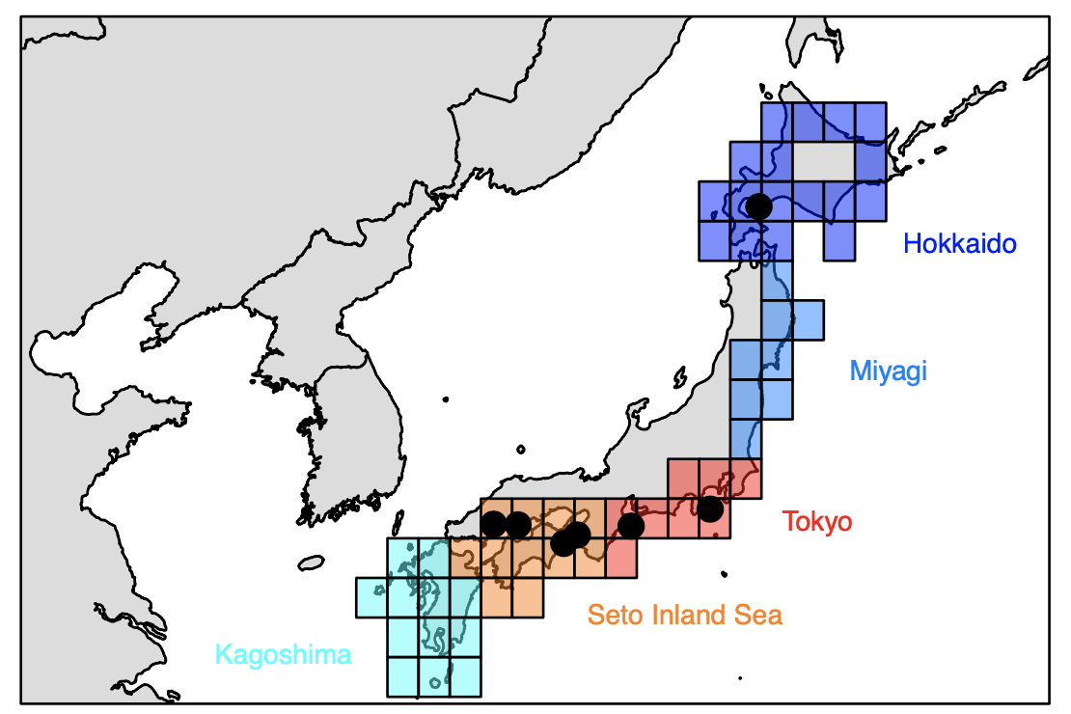
Cases with no Miyagi
Kogishi et al. - 2010 - Cutleria cylindrica
Le Cam et al 2020
Sargassum muticum

